Slide 1
DW/172
Peter Rogers BESA 20 May 2020

Slide 2
Agenda
DW/172 Addendum
Design
Kitchen ventilation systems
Recirculation Systems
COVID-19 Update
Q & A

Slide 3
DW/172 Addendum

Slide 4
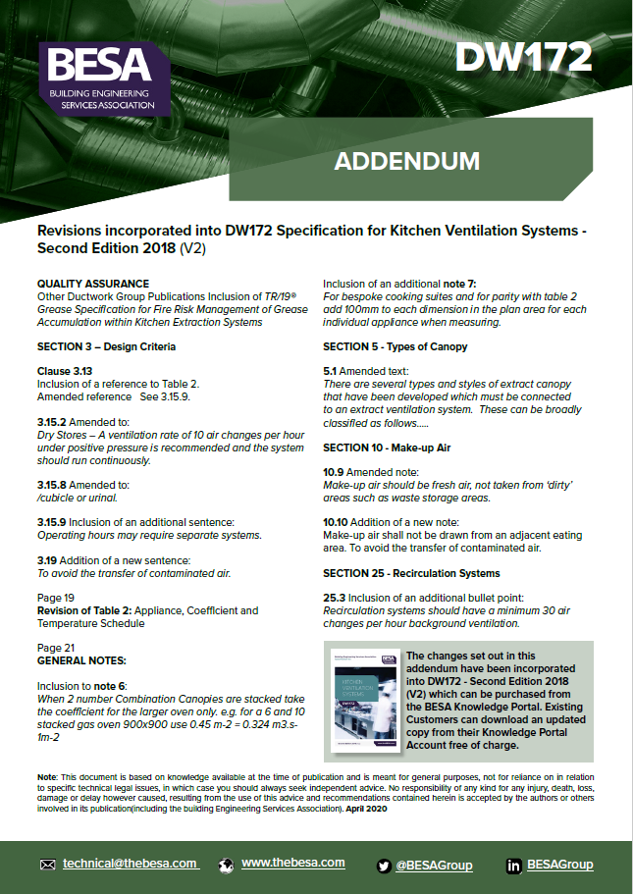
DW/172 Addendum

Slide 5
Design

Slide 6
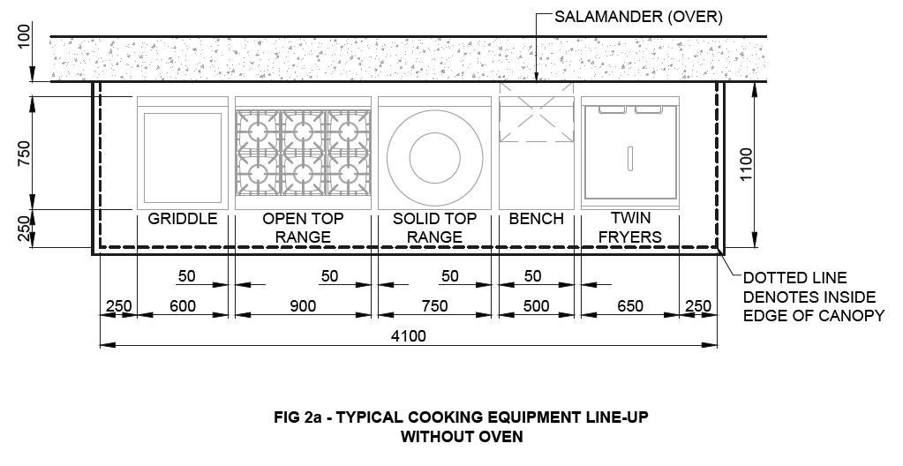
Thermal Convection Method

Slide 7
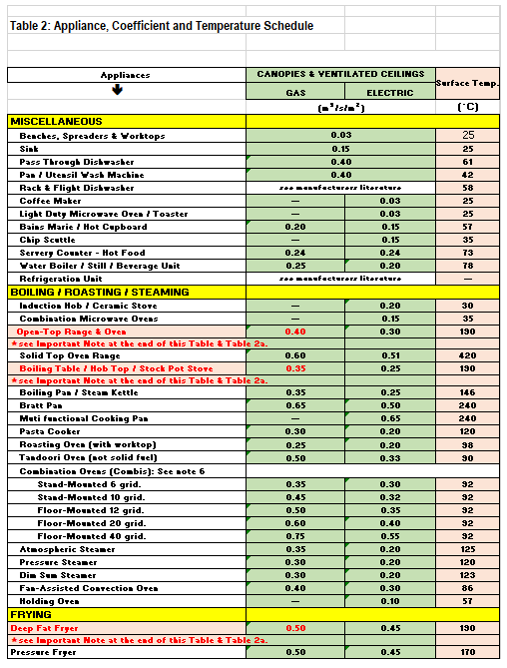
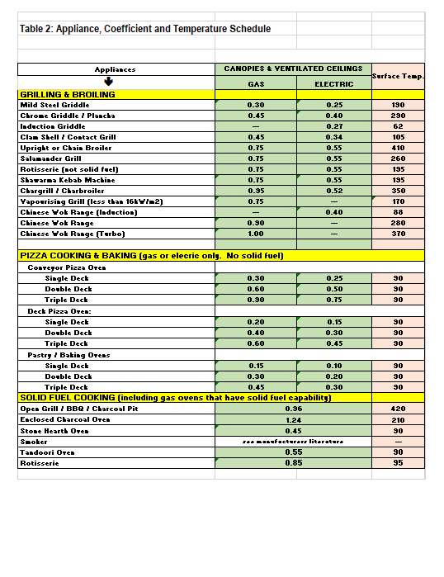
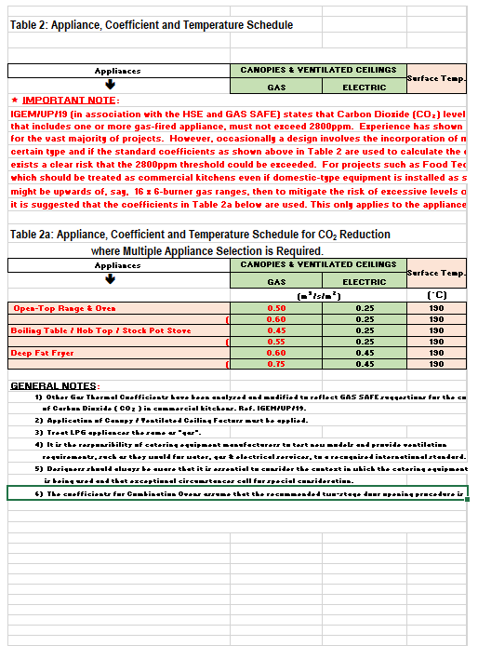
Appliance, Coefficient and Temperature Table

Slide 8
Kitchen Ventilation Systems

Slide 9
BESA Specification DW/172:2018

Slide 10
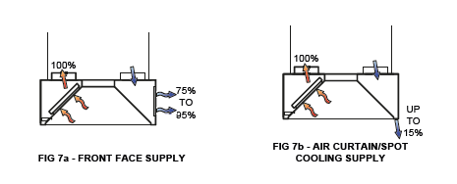
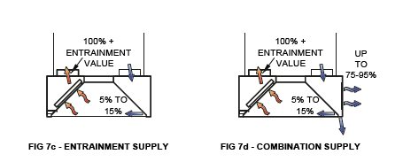
Canopies Fig 7a, 7b,7c, 7d from DW/172

Slide 11
Ventilated Ceiling System

Slide 12
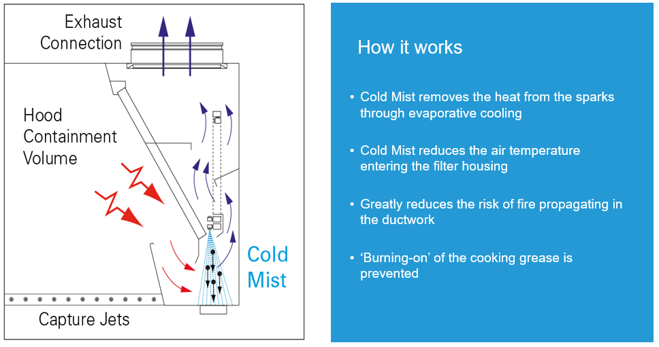
Cold Mist / Hot Wash Hoods

Slide 13
Recirculation Systems

Slide 14
BESA Specification DW/172:2018

Slide 15
COVID-19 Update Awareness

Slide 16
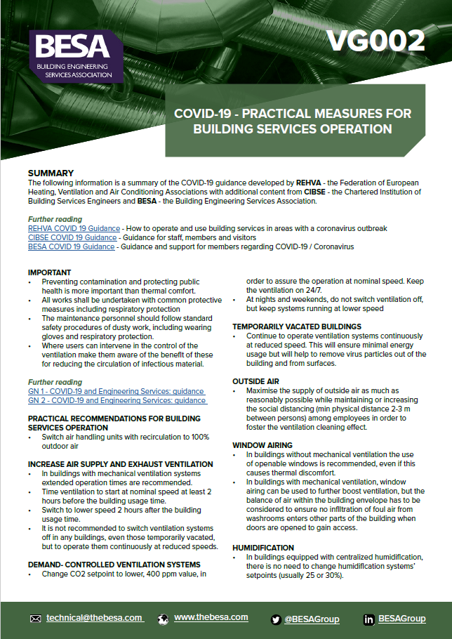
COVID-19 Update Awareness
• Make-Up-Air

Slide 17
Q & A

