Slide 1
CEDA CDM 2015 Seminar
Trainer: Tim Knowles

Slide 2
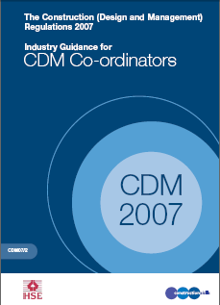
CDM - History
Original Regulations – 1994
Completely revised and updated in 2007
Currently 2015 iteration

Slide 3
Legal Structure of CDM
Construction (Design and Management) Regulations 2015
Guidance on the Regulations – L153
Guidance by industry for industry – (CITB 6)

Slide 4
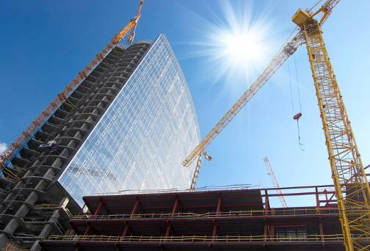
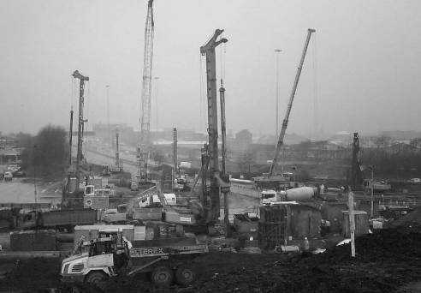
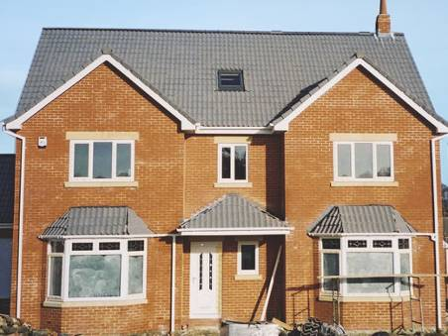
Application
In Great Britain (and outside as HSWA)
Construction work on construction sites
Where a project has more than one contractor and a design, full duties apply:
Role of Principal Designer and Principal Contractor applied for every project, irrespective of notification
Domestic clients are clients but duties are discharged to the main contractor

Slide 5
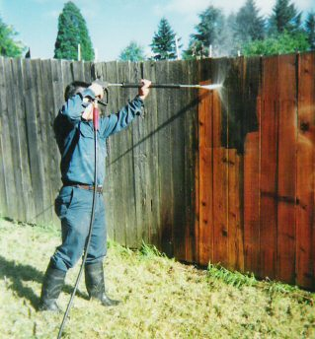
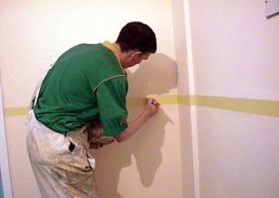
Construction Work
Construction
Alteration
Fitting out
Commissioning/Decommissioning
Renovation
Repair
Upkeep
Redecoration
Other maintenance (including cleaning with water or an abrasive at high pressure or … chemicals)

Slide 6
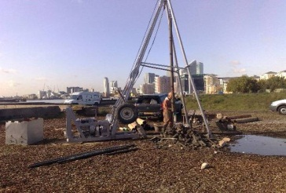
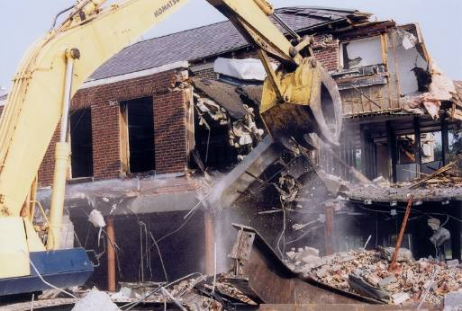
Construction Work
Temporary Works
Demolition or dismantling of a structure
Preparation for an intended structure – includes:
Site clearance
Exploration
Investigation (but not desk survey)
Excavation and removing ‘establishment’
The assembly or disassembly of prefabricated elements
Removal of a structure or part thereof
Removal of demolition or dismantling or waste produced

Slide 7
Construction
Installation, commissioning, maintenance, repair or removal of:
Mechanical, electrical, gas, compressed air, hydraulic, telecommunications, computer or similar services which are normally fixed within or to a structure

Slide 8
Key to Application
What business will not carry out construction work?
CDM to be addressed within H&S Policy and Procedures by your Safety Advisor

Slide 9
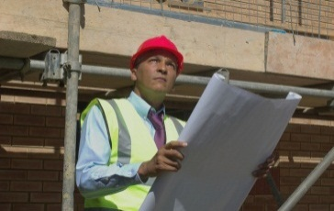
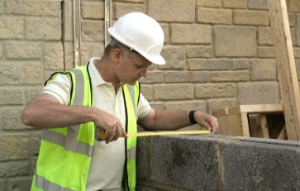
Duty Holders
Client
Principal Designers
Designers
Principal Contractors
Contractors
All “Body Corporate”

Slide 10
Clients
On all projects clients must “ensure”:
Appointment of roles with necessary skill, knowledge and experience
all duty holders (including client) make and maintain suitable arrangements for managing projects (including time and resources)
Principal Designer and Principal Contractor carry out their duties
Provide relevant information promptly
Ensure adequate “Welfare” at start and throughout

Slide 11
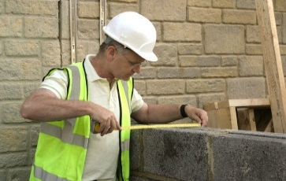
Clients
Appoint a Principal Designer
Appoint a Principal Contractor
Notify the project via F10
Ensure information promptly passed on by Principal Designer
Be aware of start of construction phase and ensure plan developed
Health and Safety file
Note: Clients assume all roles until formally appointing in writing

Slide 12
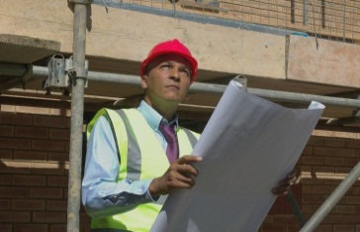
Principal Designers
Mandatory on projects where there is more than one contractor
Skills, knowledge, experience
Advise and assist client on some duties (F10)
Ensure suitable arrangements in place to manage duties
Plan, manage and monitor health and safety in the pre-construction phase

Slide 13
Principal Designers
Liaise with Principal Contractor
Collect, collate and spread information
Ensure Designers carry out their duties
Identify, eliminate or control significant risk
Co-ordinate design work during
construction (H&S)
Review, update or prepare a HSF
Pass HSF to the client

Slide 14
Designers
On all projects
Skill, knowledge and experience
Ensure Client aware of duties before starting
General principle - avoid risks
Provide information about residuals
Assist other duty holders with information on design

Slide 15
Who are Designers?
Wide definition – those who:
Anyone who prepares or modifies as design, or
Arranges for or instructs anyone under their control to do so
Duties apply to all projects including
non-notifiable and domestic.
Those who design overseas.

Slide 16
Who are Designers?
Includes:
Architects
Civil and structural engineers
Building services engineers
Landscape Architects
Transport Consultants
Those specifying or purchasing materials
Temporary works designers
Interior fit out designers
Clients who specify
D&B contractors

Slide 17
Designers Duties
Co-ordinate their work with others to manage risk
Co-operate with Principal Designer and others
Provide information for the Health and Safety file

Slide 18
Designers Duties
Designers have to avoid foreseeable risks SFARP by:
Eliminating hazards from the construction, cleaning, maintenance, and proposed use (workplace only) and demolition of a structure
Reduce risks from any remaining hazard
Give collective risk reduction measures priority over individual measures

Slide 19
Designers Do Not Need To….
Control risk on site
Assess unforeseeable hazards and risks
Design for future use outside their design brief
Specify construction methods
Manage contractors
Consider trivial risks
What do you need to do?
How can you contribute to risk reduction on site?

Slide 20
Principal Contractors
Principal Contractors duties apply on projects with more than one contractor
Prepare a Construction Phase Plan
Review, revise and refine plan
Implement plan
Relevant skill, knowledge and experience

Slide 21
Principal Contractors
Plan, manage and monitor construction phase
Liaise with Principal Designer (ongoing design)
Ensure adequate welfare
Secure the site
Draw up site rules
Direct contractors
Consult /Workers about risks
Provide Contractors with information

Slide 22
Principal Contractors
Tell Contractors what is needed for HSF and when and how to provide it
Display F10 where workers can read it
where relevant
Ensure everyone has induction and training

Slide 23
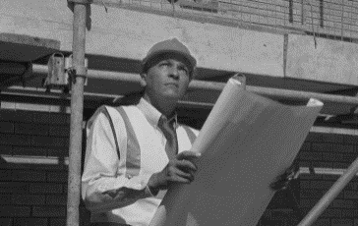
Contractors
Ensure Client aware of their duties before starting work
Plan, manage and monitor work
Provide workers with suitable information
Train employees
Ensure they have adequate welfare – Schedule 2

Slide 24
Contractors
On all projects, contractors must ensure:
Demolition or dismantling (Reg 20)
Communicated in writing “Written plan of work” regardless of scale
Reports of inspections
Regulation 24
Schedule 3

Slide 25
Contractors
Adhere to restrictions on start of work
Provide PC with risk information
Work with the PC, comply with the plan, take other measures where they cannot comply, tell PC where it is necessary to alter or add to the plan
Provide information for the HSF

Slide 26
Notification
Project becomes notifiable when works are scheduled to:
Last more than 30 working days AND have more than 20 workers working simultaneously
Exceed 500 person days
Must be:
Displayed
Retain particulars in Schedule 1

Slide 27
Key Documentation
Pre-Construction Information
Construction Phase Plan
Health and Safety File

Slide 28
Any Questions

